Slide 1
Deep Neural Networks
PhD Abay Nussipbekov

Slide 2

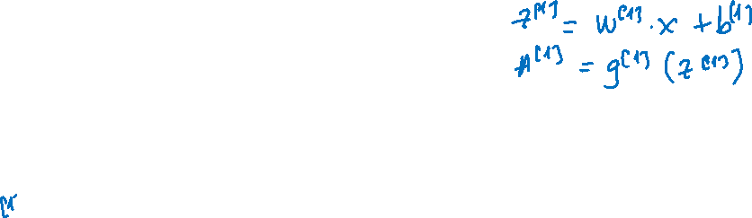


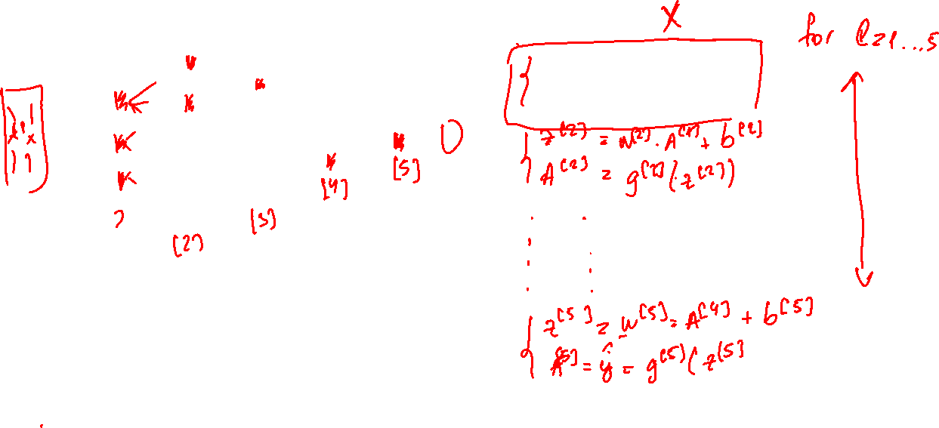
Iterating through DNN layers
$$x_{1}$$
$$\hat{y}$$
$$x_{2}$$

Slide 3
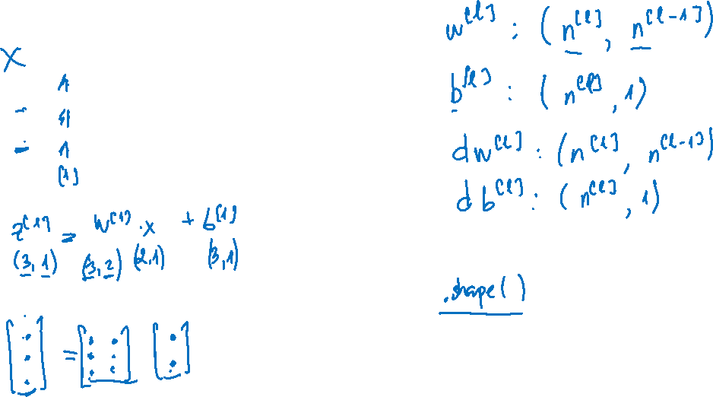
Dimensions
$$x_{1}$$
$$\hat{y}$$
$$x_{2}$$

Slide 4
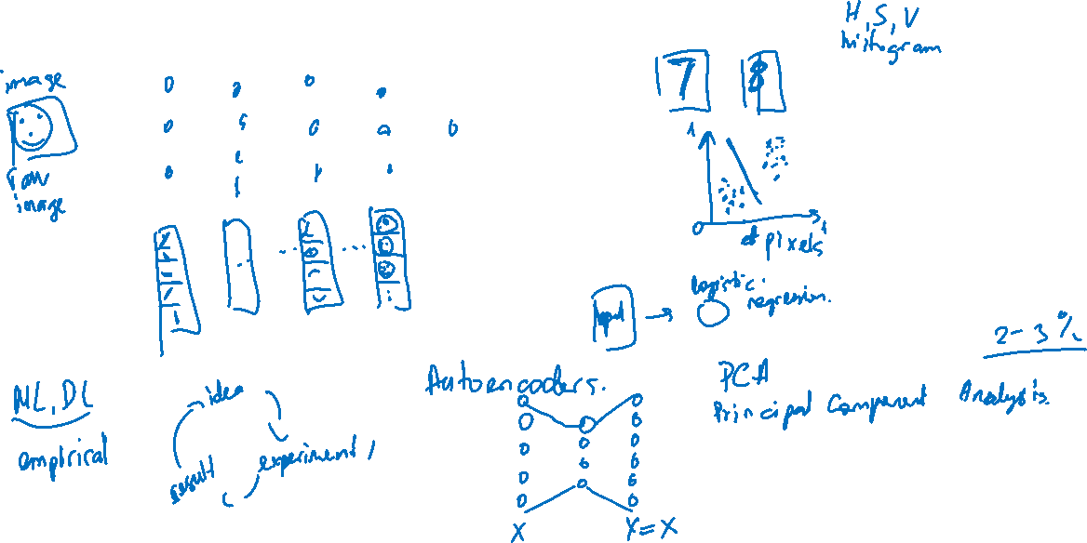
Automatic feature learning in DNN

Slide 5
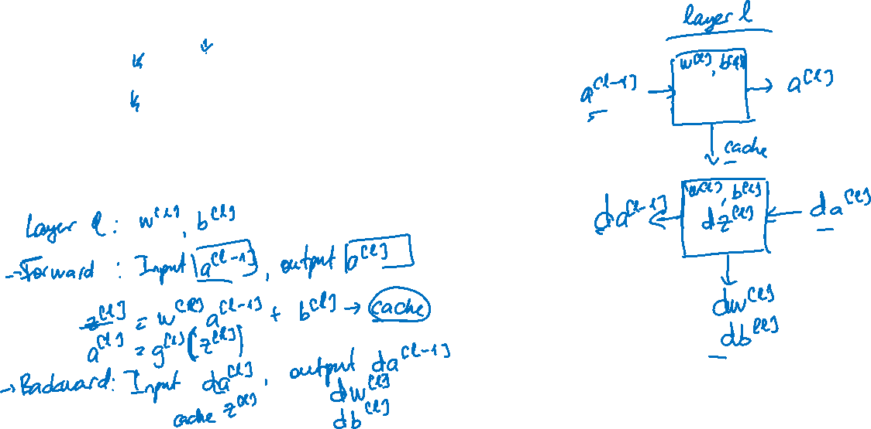





Forward and backward functions
$$x_{1}$$
$$x_{2}$$
$$\hat{y}$$
$$x_{3}$$
$$x_{4}$$

Slide 6
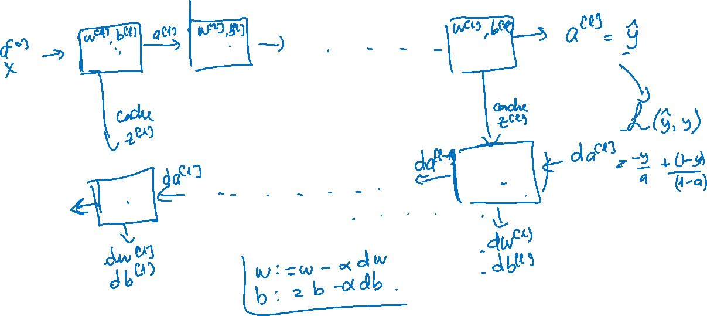
Forward and backward functions

Slide 7
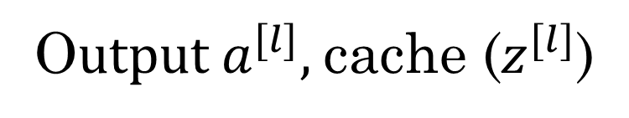
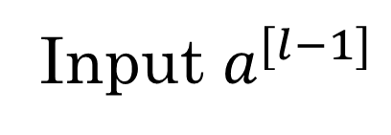
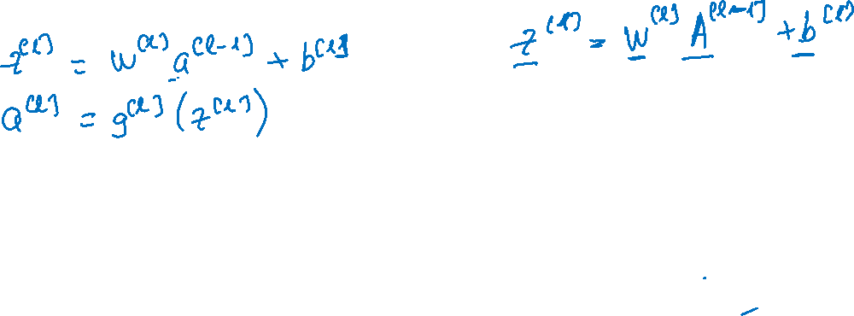
Forward propagation for layer l
Input $a^{[l−1]}$
O$utput a^{[l]},$cache ($z^{[l]}$)

Slide 8
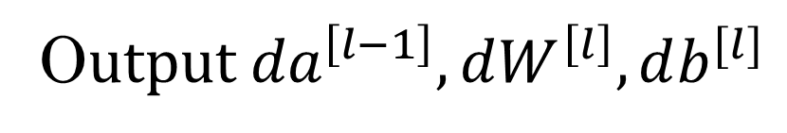
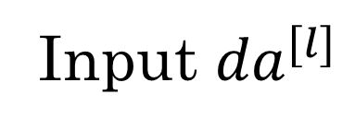
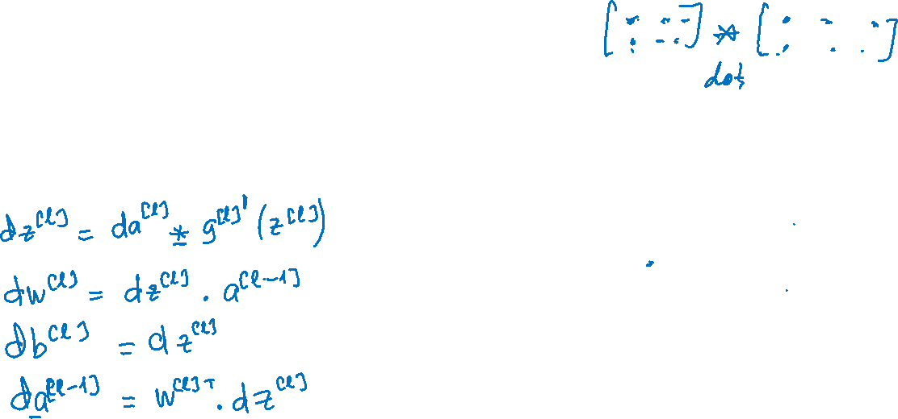
Backward propagation for layer l
Input ${da}^{[l]}$
O$utput {da}^{\left[l−1\right]},dW^{\left[l\right]},db^{[l]}$

Slide 9
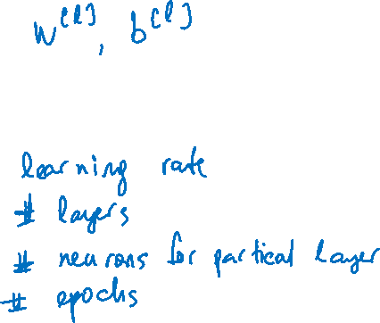
Hyperparameters
Parameters:
Hyperparameters:

